Slide 1
Traffic Accident Pattern Analysis
Team Members Roll No.
Dikesh Manandhar THA081BCT031
Riki Karn THA081BCT030
Ronit Shrestha THA081BCT031
Under the supervision of
Er. Suwarna Lingden
Department of Electronics and Computer Engineering
IOE, Thapathali Campus
March 17, 2026

Slide 2
Outline
Introduction
Problem Statement
Objective
Methodology
Mathematical Overview
Data Cleaning
Feature Engineering
DBSCAN Results and KDE heatmaps
Moran's I
Key Findings
Cross Validation
Conclusions & Policy Recommendations

Slide 3
Introduction
A traffic accident is an unplanned event involving one or more vehicles that results in damage, injury, or death.
Daily Average: About 65–75 road accidents occur every day in Nepal, resulting in roughly 7 people killed and around 80 injured daily according to recent Nepal Police reports.

Slide 4
Problem Statement
Nepal has highest traffic accident rates per capita in South Asia, with thousands of deaths and injuries annually
Despite this there is not so much study carried out related to this
Most official reports provide counts and locations, but do not analyze patterns, clusters, or risk factors in depth.

Slide 5
Objective
Understand Spatial Patterns
Validate Methods Statistically
Enable Evidence-Based Policy
Help stakeholders prioritize safety measures, road improvements, and awareness campaigns.

Slide 6
Methodology
Data Collection
Data Preprocessing and Cleaning
Feature Engineering
DBSCAN Clustering
Result and Conclusion
Visualization
Morans' I index
KDE Heatmap

Slide 7
Mathematical Overview
DBSCAN
DBSCAN is a density-based clustering algorithm.
It groups closely packed points and labels isolated points as noise (outliers).
Useful for spatial data, accident hotspots, and irregular cluster shapes
ε (Epsilon):Radius that defines the neighborhood distance around a point.
Nε(p) = { q ∈ D | dist(p,q) ≤ ε }

Slide 8
MinPts: Minimum number of points required to form a dense region.
Condition:
|Nε(p)| ≥ MinPts
Core Point:A point with enough neighbors.
|Nε(p)| ≥ MinPts
Border Point:Not a core point but lies within the ε-neighborhood of a core point.
|Nε(p)| < MinPts but p ∈ Nε(core)

Slide 9
DENSITY REACHABILITY:Point q is directly density-reachable from p if:
q ∈ Nε(p) and |Nε(p)| ≥ MinPts
DENSITY CONNECTIVITY:Two points p and q are density-connected if there exists a point o such that both are density-reachable from o.
p → o → q

Slide 10

Kernel Density Estimation
estimate the probability density function (PDF) of data and Produces a continuous density surface
Where, n = total number of data points
h = bandwidth (smoothing parameter)
K = kernel function (gaussian kernel)
xi = observed data points
f(x) = estimated density

Slide 11



Moran’s I index
global Moran’s I is used to examine whether the crash locations and attributes exhibit any regularity
i.e. whether they are spatially clustered, dispersed or random.

Slide 12
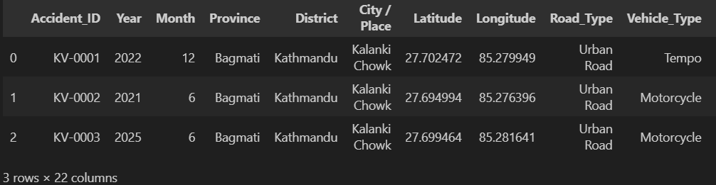
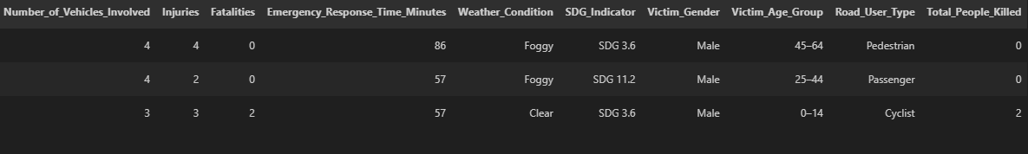
Dataset

Slide 13
Data Cleaning
Removed whitespace from all text columns
Checked duplicates: 0 fully duplicate rows
Checked Null Values
Validated coordinates: All within Nepal bounds
Checked numeric columns: No negative values found
Checked categorical Intigrity
Logically sorted the data both column and row wise

Slide 14
Feature Engineering
Severity Score Creation:
Combines: Fatalities (3× weight) + Injuries (1× weight)
Normalized 0–1 for comparison
Interpretation: 0 = no harm, 1 = worst accident in dataset
Risk Score Creation:
Weighted combination:
40% Severity Score
20% High-Risk Road (Hill Road, Ring Road)
20% Bad Weather (Rainy, Foggy)
20% High-Risk Cause (Drunk Driving, Over speeding, Road Condition)

Slide 15
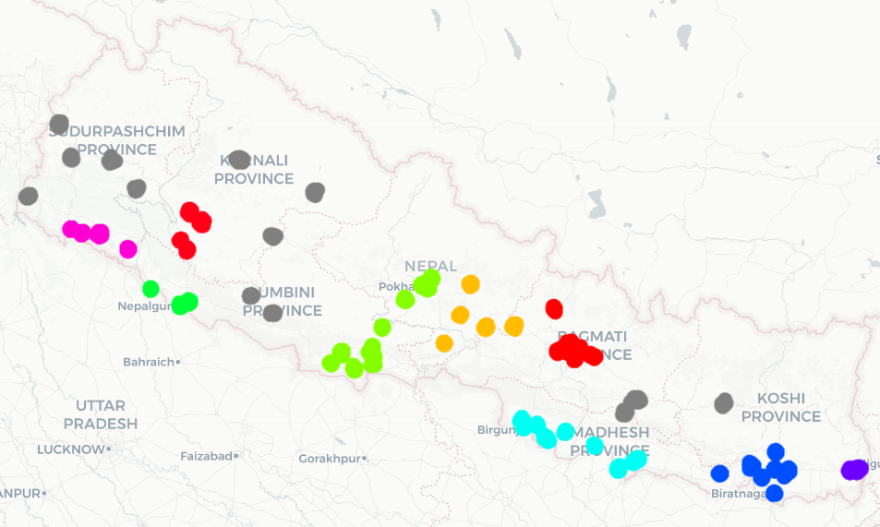
DBSCAN Results
Where Are the Hotspots?
(According to Accident Frequency)
Color->Cluster
Black->Noise
Bagmati Province (red) is the most dense ->highest risk zone near Kathmandu
Terai belt (Lumbini, Madhesh, Koshi) shows multiple clusters along highway corridors

Slide 16
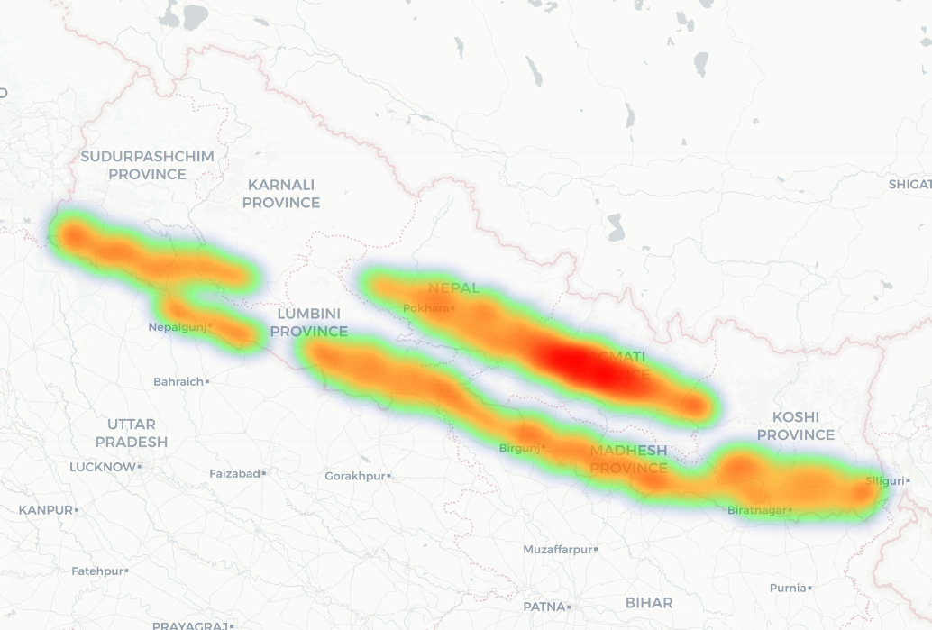
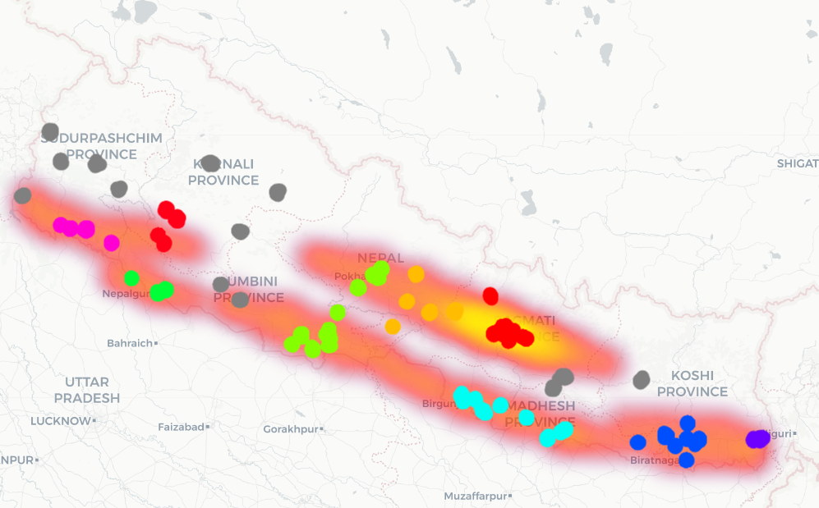
KDE Heatmap
Severity Based
Risk Based
A strong east-west hotspot band runs along the Terai highway corridor
Karnali and mountain regions remain cool — low severity activity
Combine cluster with KDE
DBSCAN clusters align perfectly with high-risk KDE zones — validating both methods

Slide 17
Moran's I index
Measures whether similar values cluster together in space or are randomly spread
+1 clustered,
0 = random
-1= dispersed
Metric | Severity Score | Risk score
Moran’s I | 0.0116 | 0.0652
P-Value | 0.0420 | 0.0010
Z-score | 1.749 | 9.742
Interpretability | Significant positive spatial autocorrelation | Significant positive spatial autocorrelation

Slide 18
Interpretation
Severity Score
Moran's I is nearly 0 ->severity is almost randomly distributed across Nepal
Statistically significant only due to large sample size (n = 5000), not strong clustering
Risk Score
Shows weak but consistent spatial clustering -> high risk zones tend to be near each other
Highly significant (p = 0.001, z = 9.74) -> clustering is real but modest in magnitude

Slide 19
Key Findings and Analysis
Geographic and Spatial Analysis
Accident Characteristic and Cause
Vehicle Distribution
Human Impact
Environment Impact

Slide 20
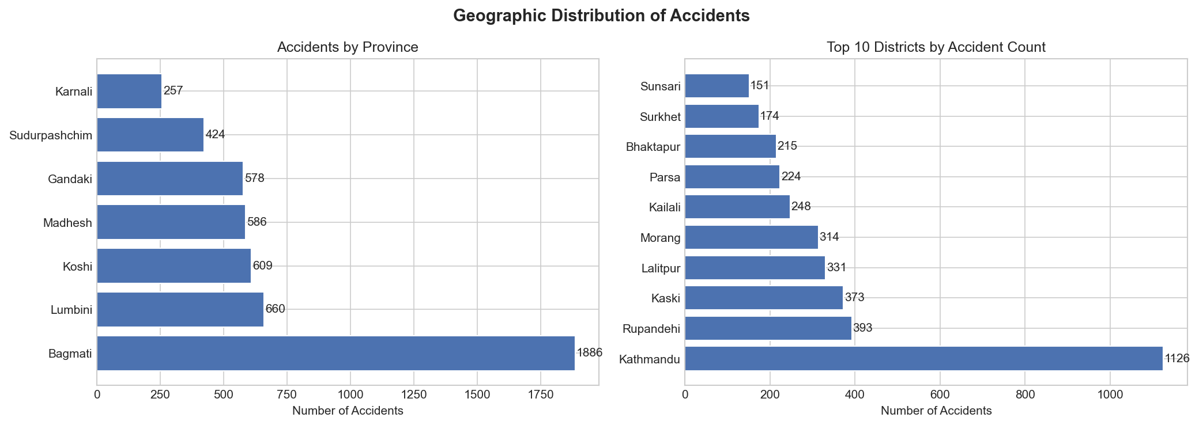
Geographic and Spatial Analysis

Slide 21
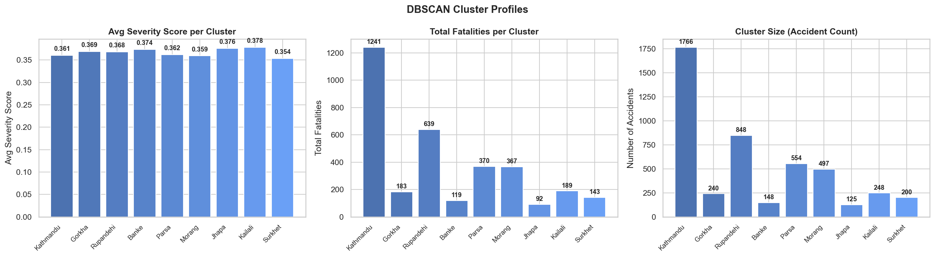
Geographic and Spatial Analysis

Slide 22
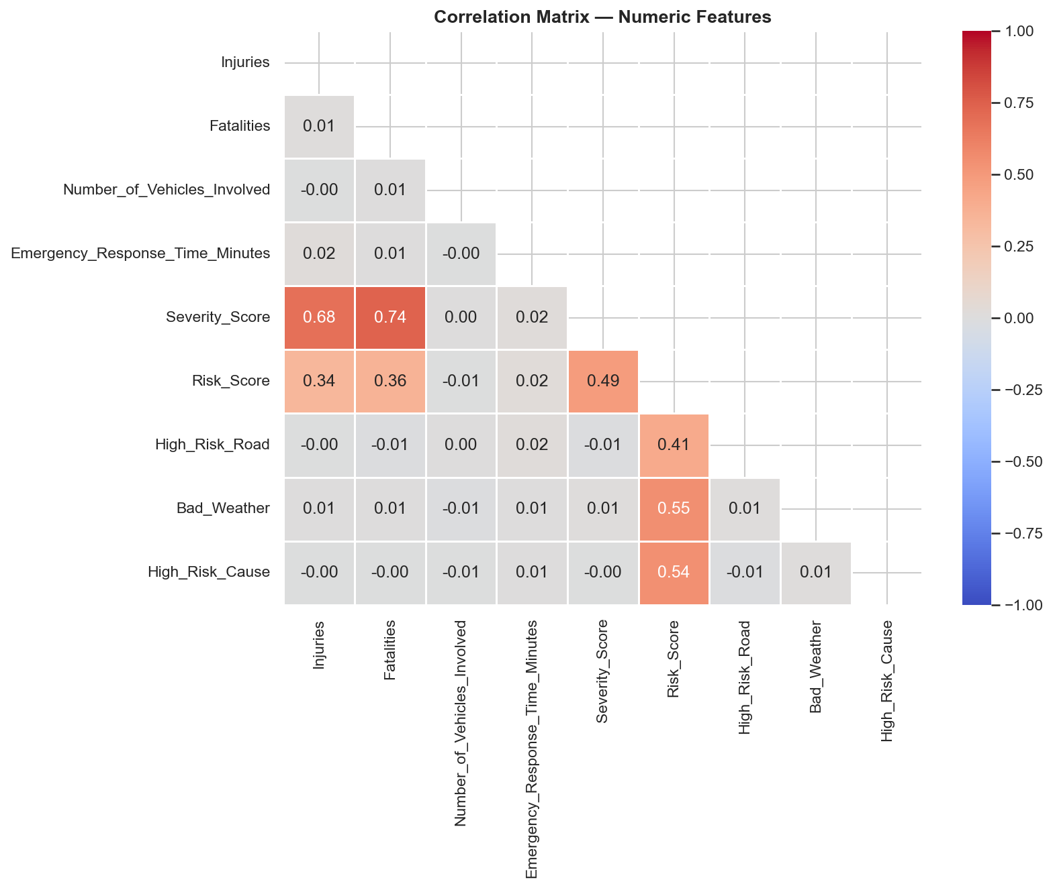
Correlation Matrix

Slide 23
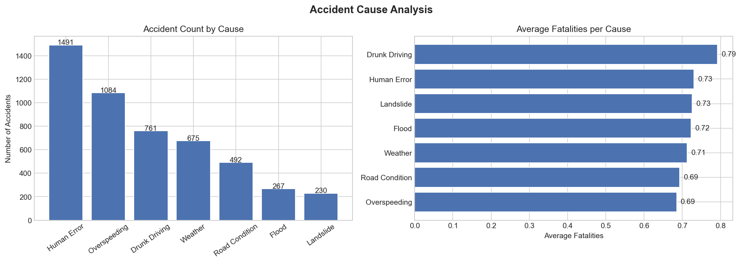
Accident Characteristic and Causes

Slide 24
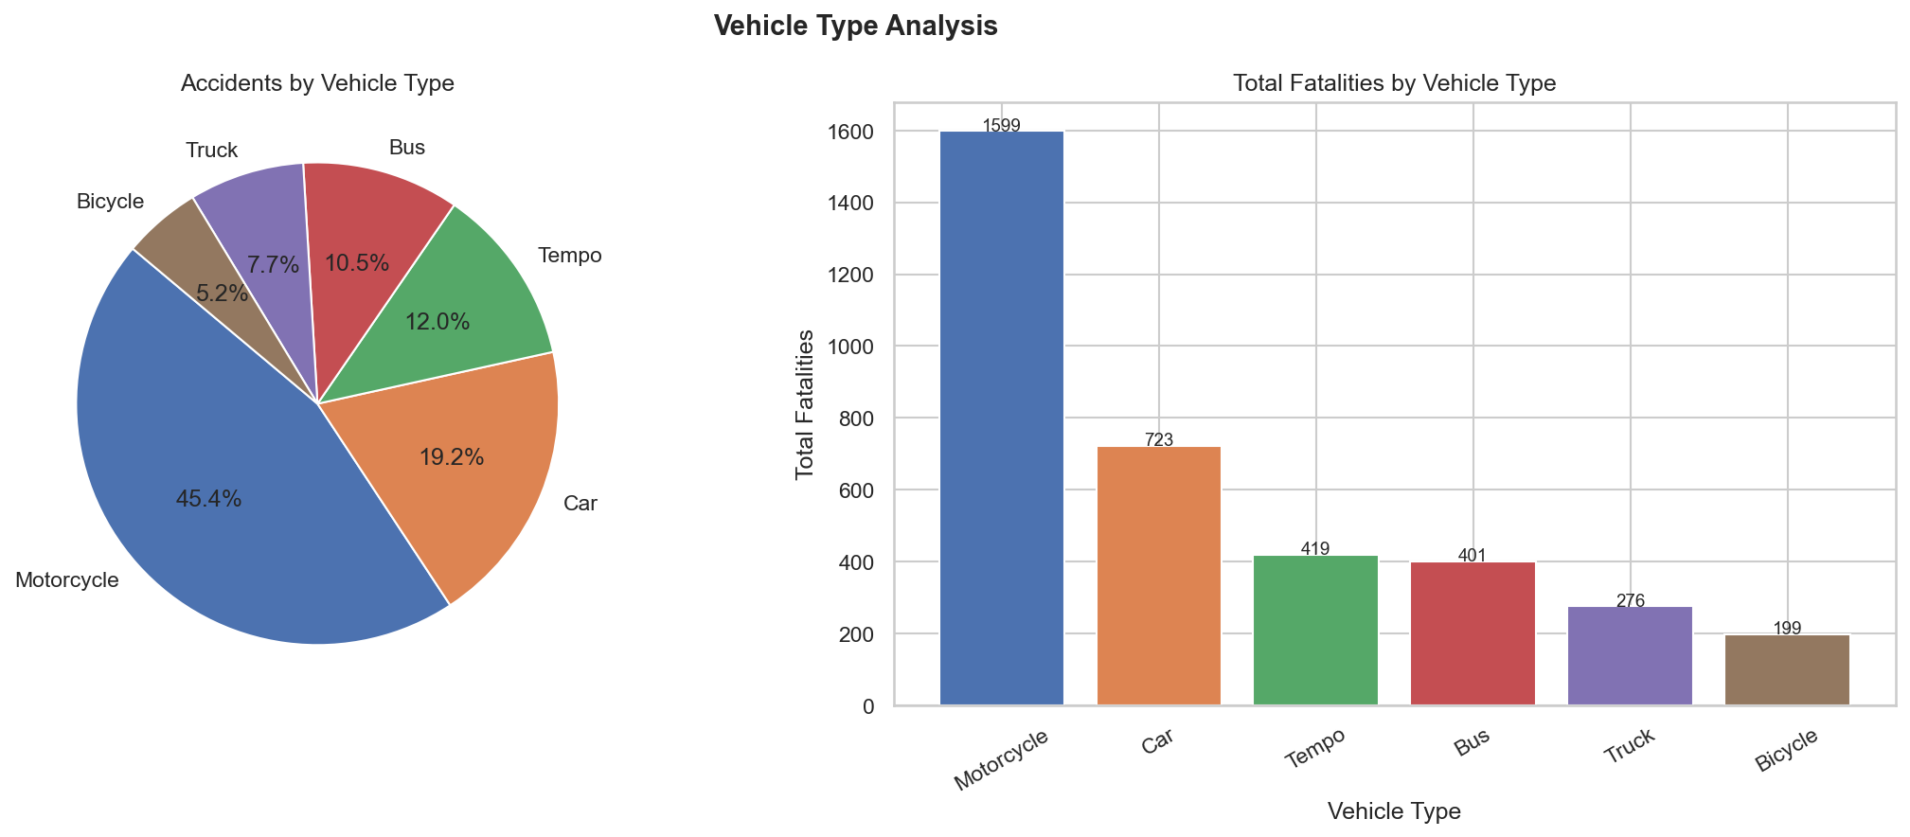
Vehicle Distribution

Slide 25
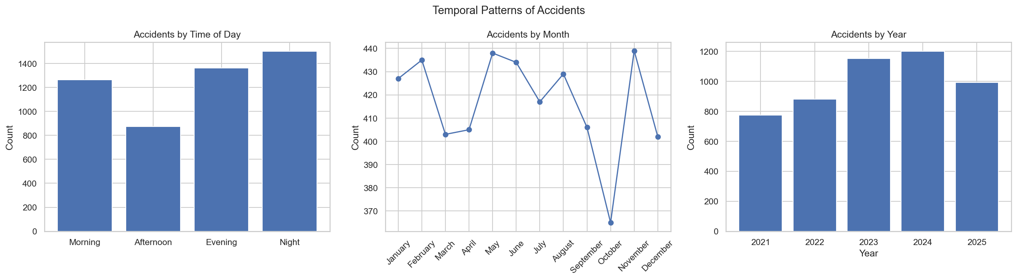
Temporal Pattern

Slide 26
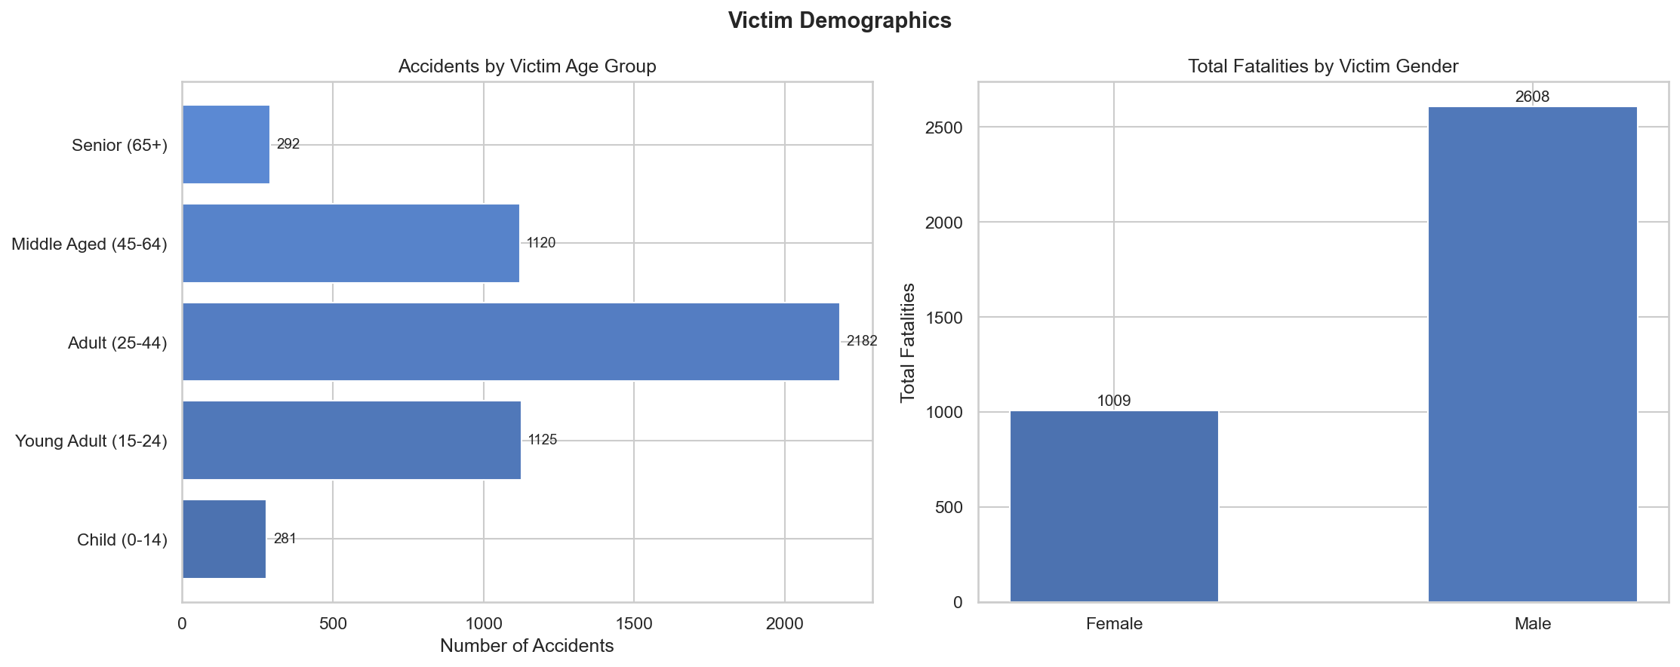
Human Impact

Slide 27
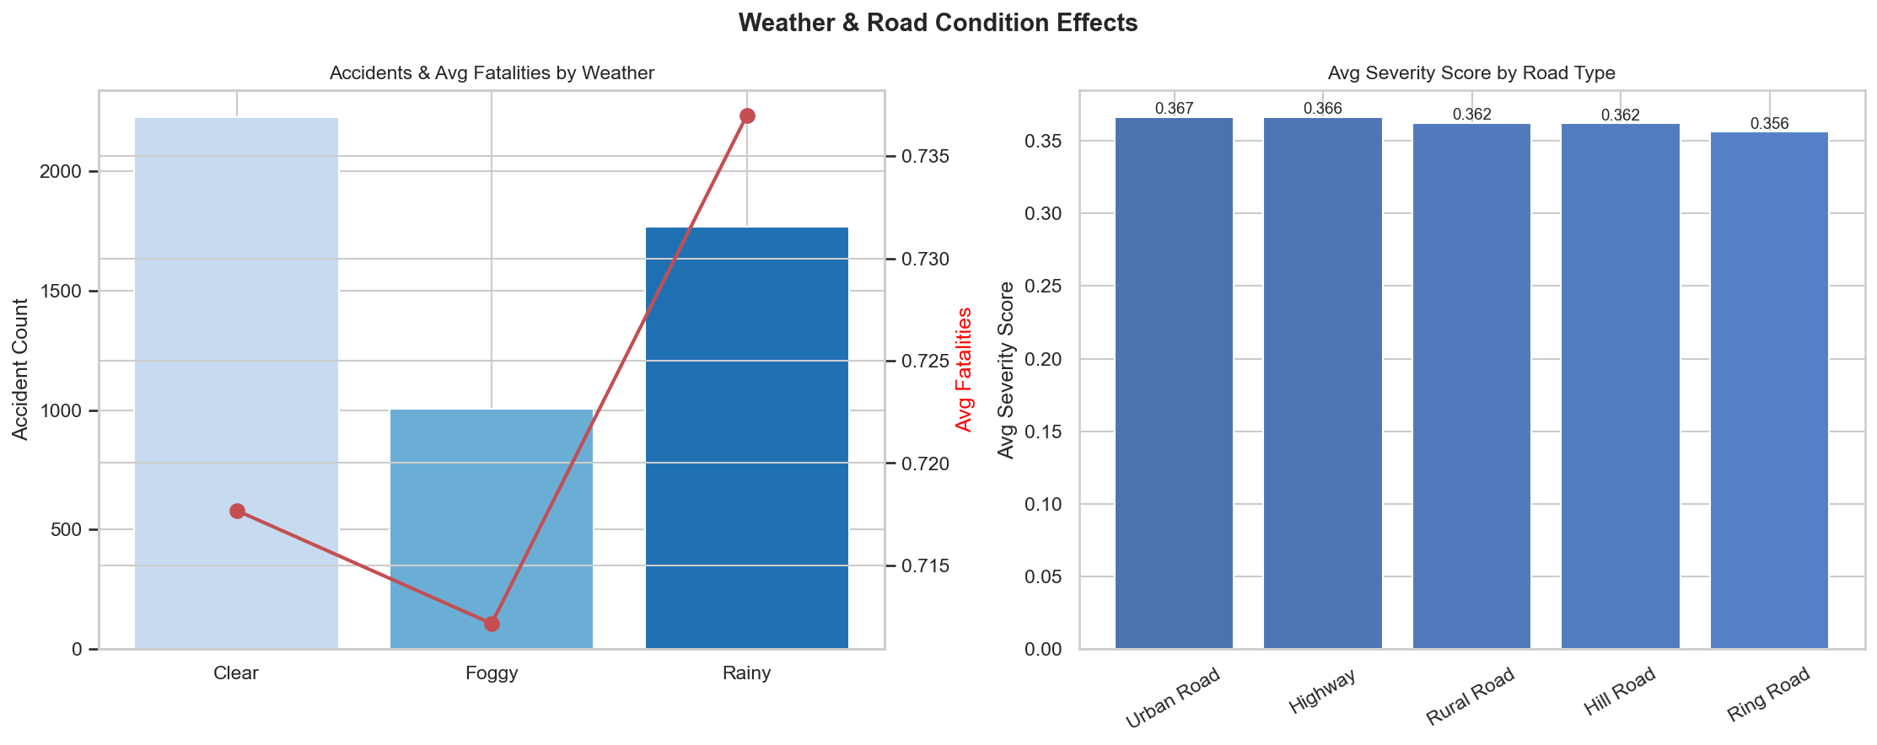
Environmental Impact

Slide 28
Cross Validation
Overall score of 0.7027 confirms strong cluster separation ,above the 0.50 benchmark
7 out of 9 clusters score above 0.55, proving DBSCAN parameters were well tuned
Clusters 0 and 6 score above 0.90 ,near perfect separation in those regions
Weak scores in Cluster 2 and 4 reflect genuine geographic overlap, not model error

Slide 29
Result and Conclusion
Result
9 accident clusters found : mostly along Terai highway and Kathmandu valley
Bagmati Province has the highest accident severity and risk in Nepal
Risk scores cluster weakly but significantly : accidents are not by chance
DBSCAN clustering validated with 0.70 silhouette score that means results are reliable
Conclusion
urban centers and highways are most dangerous
Three methods together (DBSCAN + KDE + Moran's I) give stronger and trusted results
Northern hilly and mountain regions are comparatively safer than Terai and Bagmati
Data science can effectively identify where and why accidents happen in Nepal

Slide 30
Ethics and Recommendation
Ethics
All data used is anonymized ,no personal identity of victims is revealed
Study is purely for public safety improvement, not surveillance or profiling
Findings should not be used to discriminate against any region or community
Recommendation
Fix roads and infrastructure at top hotspot clusters like Bagmati, Koshi, Lumbini
Add speed cameras and traffic police at identified high risk junctions
Improve street lighting and signage in night accident prone clusters
Place ambulances and hospitals closer to high fatality cluster zones
Run awareness drives in top accident districts like Kathmandu, Biratnagar, Butwal

